Slide 1

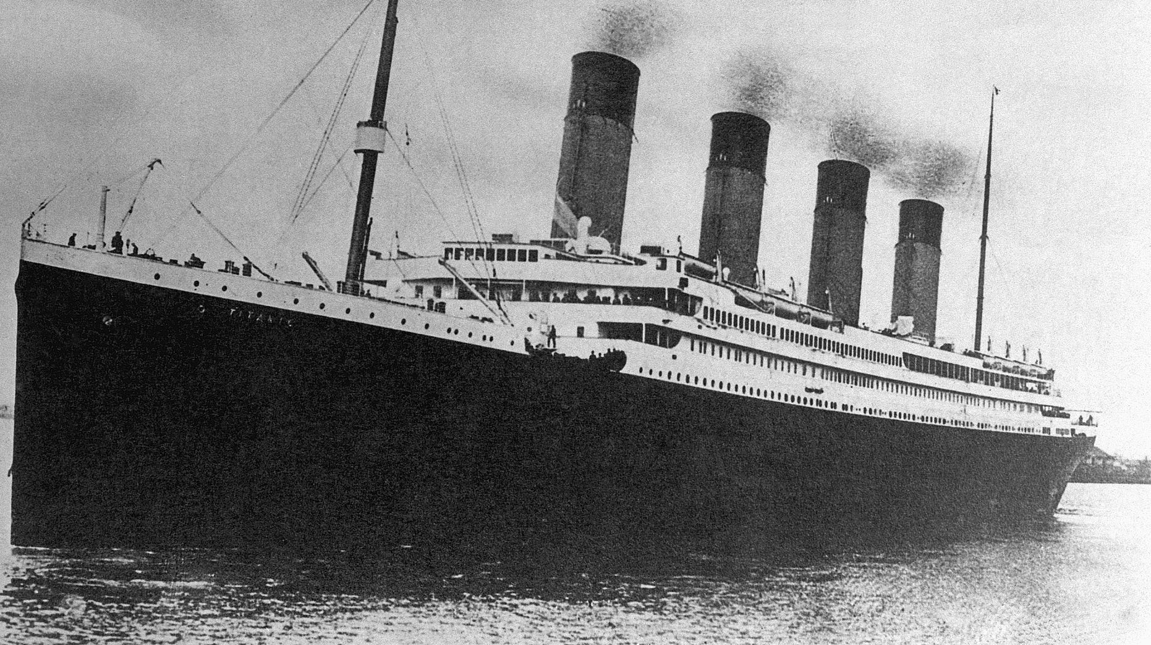
The Titanic
B”H
Factors of Survival:

Slide 2
Statistical Question & Hypothesis
Question: Did the ticket fair paid influence a passenger’s chance for survival on the Titanic?
Hypothesis: Yes; the average fare for passengers who survived is higher than for those who did not survive.

Slide 3
Selecting the Variables
Survived: Whether or not the passenger survived (0 or 1).
Pclass: Passenger class (First, Second, Third).
Age: Age of the passenger.
Fare: Price paid for the ticket in USD.
FamilySize: Number of family members of the passenger aboard.

Slide 4
Characteristics of Variables
Survived: Categorical
Pclass: Categorical
Age:
Mean: 29.5
Mode: 22
Spread: 14.12
Kurtosis: 0.29
Fare:
Mean: 32.31
Mode: 8.05
Spread: 49.78
Kurtosis: 33.26
FamilySize:
Mean: 0.90
Mode: 0
Spread: 1.62
Kurtosis: 9.11

Slide 5
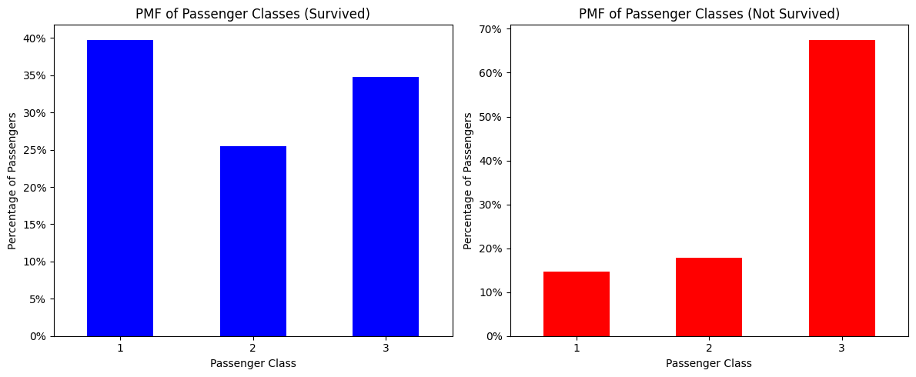
PMFs of Passenger Class (Survival)

Slide 6
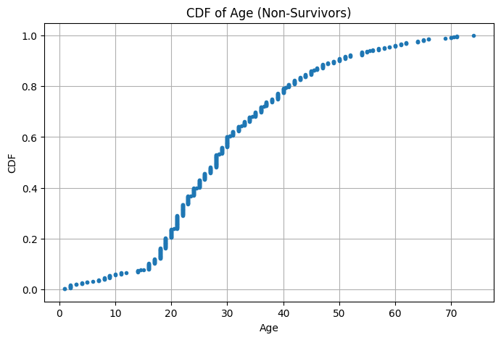
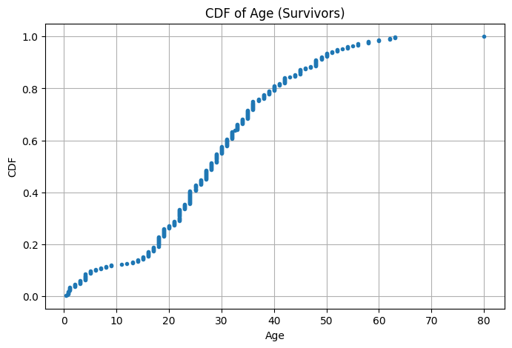
CDFs of Age
The CDFs of age in 2 groups are observed: Survivors and Non-Survivors.
There is a leftward shift from the Non-Survivors CDF to the Survivors CDF.
The shift indicates that the Survivors group tended to be younger.

Slide 7
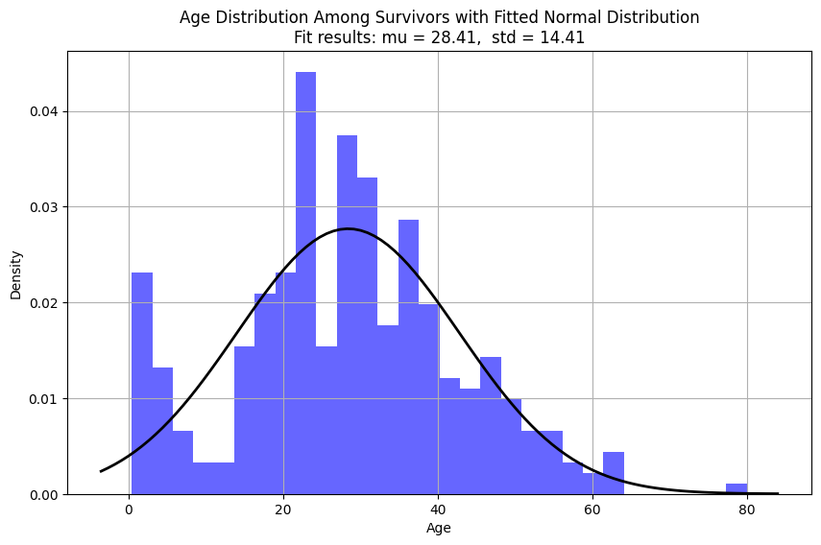
Analytical Distribution
The mean age of survivors was 28.41 years, down from the overall age mean of 29.5
This suggests that overall, younger people had a higher chance of survival.
The initial peak for infants and very young children may be indicative of the “women and children first” protocol.

Slide 8
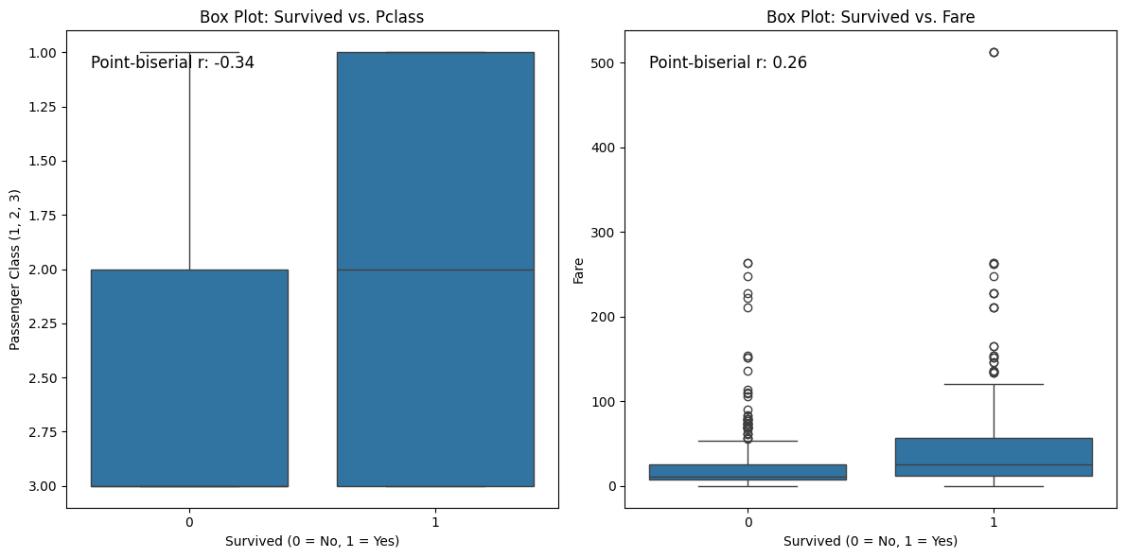
Correlation and causation
Box plots rather than scatter plots were chosen, since the ‘Survived’ variable is binary and the Passenger Class is non-continuous.
Point-biserial correlation is used in place of Pearson’s
The negative point-biserial correlation (r = -0.34) indicates a moderate inverse relationship between passenger class and survival
The positive point-biserial correlation (r = 0.26) shows a moderate positive relationship between fare price and survival

Slide 9
Permutation test
Observed difference in means: 26.186823565641937
P-value: 0.0
There is a significant difference in the means of fares between survivors and non-survivors.
The null hypothesis that there is no difference in fares between the two groups is rejected.
Passengers who paid higher fares had a higher likelihood of survival.

Slide 10
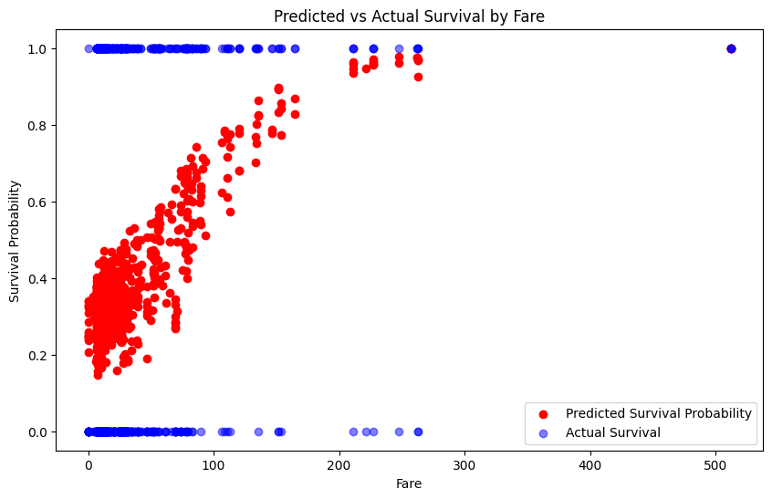
Regression Analysis: Logistic Regression

